Slide 1
Unit 3

Slide 2
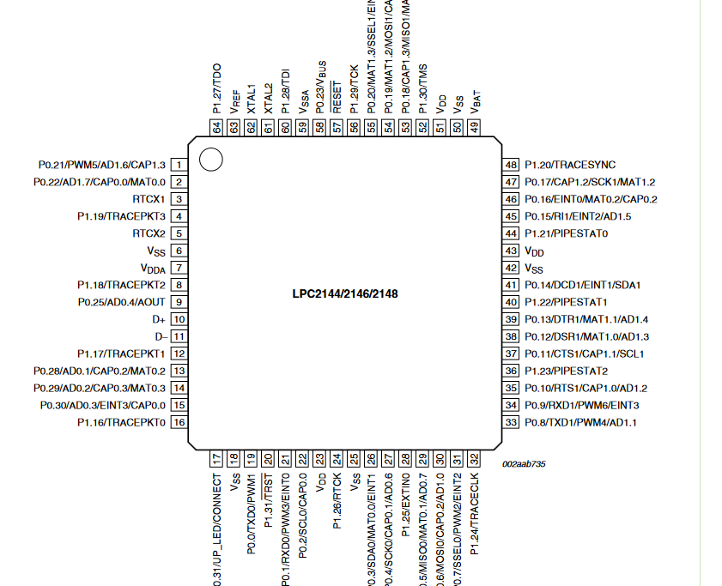
Lpc 2148

Slide 3
Pin connect block
Features : Allows individual pin configuration.
Applications : The purpose of the Pin connect block is to configure the microcontroller pins to the desired functions.
Description : The pin connect block allows selected pins of the microcontroller to have more than one function.
Configuration registers control the multiplexers to allow connection between the pin and the on chip peripherals.
Peripherals should be connected to the appropriate pins prior to being activated, and prior to any related interrupt(s) being enabled.
Activity of any enabled peripheral function that is not mapped to a related pin should be considered undefined.
Selection of a single function on a port pin completely excludes all other functions otherwise available on the same pin

Slide 4
PINSEL Register
A 32-bit register is used to select the function of the pins in which the user needs it to operate. As I said there are four functions for each pin of the controller, and the first function was GPIO ( General Purpose Input Output ). It means that the pin can either act as an Input or Output with no specific functions.
There are totally three PINSEL registers in LPC2148 Controller in order to control the functions of the Pins in the respective ports. The classification is given below

Slide 5
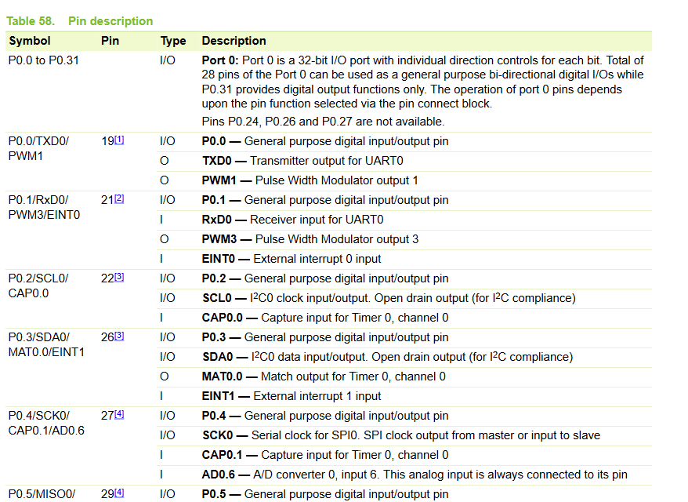
Pin description for LPC2141/2/4/6/8

Slide 6
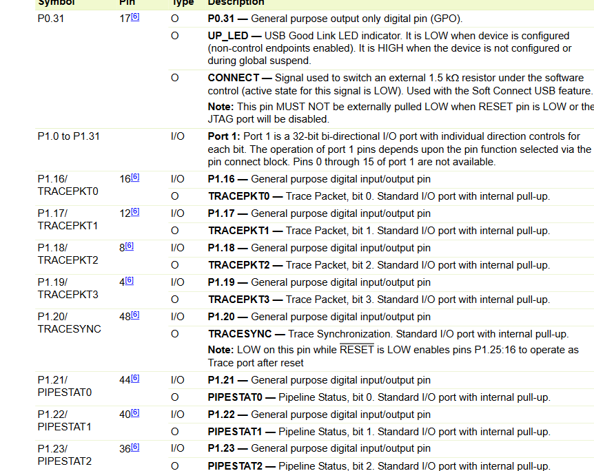

Slide 7
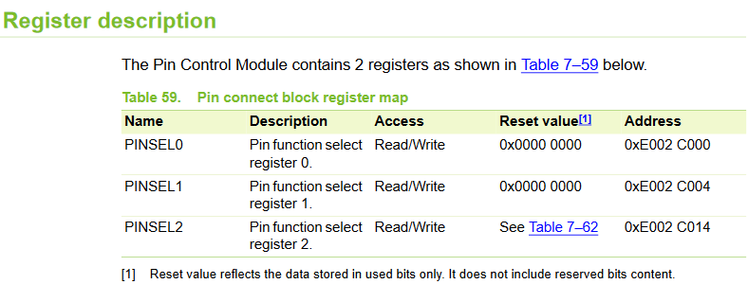

Slide 8
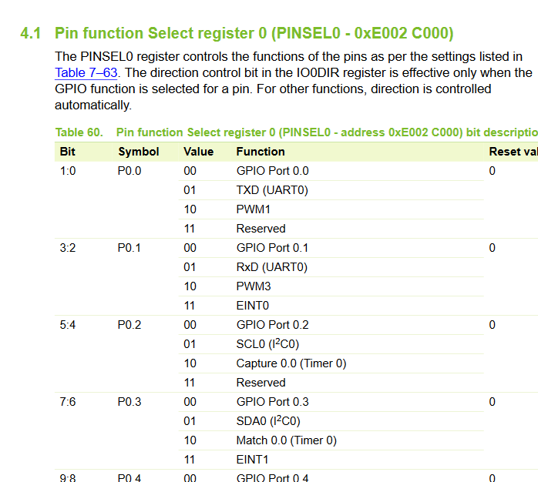

Slide 9
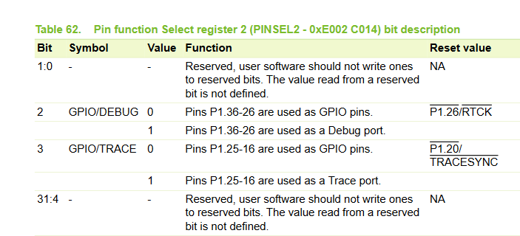
Pin function Select register 1 (PINSEL1 - 0xE002 C004) The PINSEL1 register controls the functions of the pins as per the settings listed in following tables. The direction control bit in the IO0DIR register is effective only when the GPIO function is selected for a pin. For other functions direction is controlled automatically. Pin function Select register 2 (PINSEL2 - 0xE002 C014) : It controls the functions of the pins as per the settings listed in Table below. The direction control bit in the IO1DIR register is effective only when the GPIO function is selected for a pin. For other functions direction is controlled automatically.

Slide 10
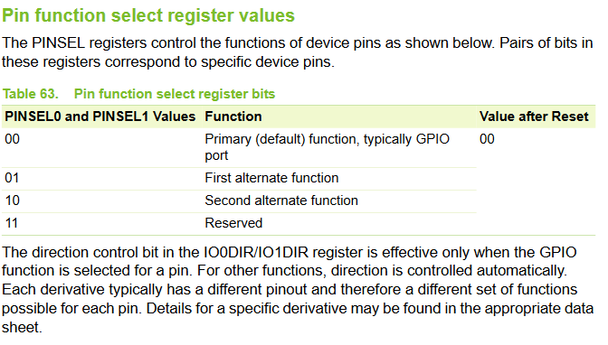

Slide 11
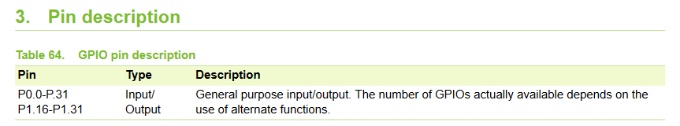
General Purpose Input/Output ports (GPIO):
Applications
• General purpose I/O
• Driving LEDs, or other indicators
• Controlling off-chip devices
• Sensing digital inputs

Slide 12
Introduction to GPIO
General-purpose input/output (GPIO) is a pin on an IC (Integrated Circuit). It can be either input pin or output pin, whose behaviour can be controlled at the run time. A group of these pins is called a port (Example, Port 0 of LPC2148 has 32 pins).
LPC2148 has two 32-bit General Purpose I/O ports.
1. PORT0
2. PORT1
PORT0 is a 32-bit port.
Out of these 32 pins, 28 pins can be configured as either general purpose input or output.
1 of these 32 pins (P0.31) can be configured as general-purpose output only.
3 of these 32 pins (P0.24, P0.26 and P0.27) are reserved. Hence, they are not available for use. Also, these pins are not mentioned in pin diagram.
PORT1 is also a 32-bit port. Only 16 of these 32 pins (P1.16 – P1.31) are available for use as general-purpose input or output.

Slide 13
Fast and Slow GPIO Registers : There are 5 Fast GPIO Registers and 4 Slow GPIO Registers available to control PORT0 and PORT1.
Slow GPIO Registers:
1. IOxPIN (GPIO Port Pin value register): This is a 32-bit wide register. This register is used to read/write the value on Port (PORT0/PORT1). But care should be taken while writing. Masking should be used to ensure write to the desired pin.
2. IOxSET (GPIO Port Output Set register) : This is a 32-bit wide register. This register is used to make pins of Port (PORT0/PORT1) HIGH. Writing one to specific bit makes that pin HIGH. Writing zero has no effect.
Examples:
a) Writing 1 to P0.4 using IO0PIN
IO0PIN = IO0PIN | (1<<4)
b) Writing 0 to P0.4 using IO0PIN
IO0PIN = IO0PIN & (~(1<<4) )
c) Writing F to P0.7-P0.4
IO0PIN = IO0PIN | (0x000000F0)

Slide 14
3. IOxDIR (GPIO Port Direction control register) : This is a 32-bit wide register. This register individually controls the direction of each port pin. Setting a bit to ‘1’ configures the corresponding pin as an output pin. Setting a bit to ‘0’ configures the corresponding pin as an input pin.
4. IOxCLR (GPIO Port Output Clear register) : This is a 32-bit wide register. This register is used to make pins of Port LOW. Writing one to specific bit makes that pin LOW. Writing zeroes has no effect.
Examples:
a) Configure pin P0.0 to P0.3 as input pins and P0.4 to P0.7 as output pins.
IO0DIR = 0x000000F0;
b) Configure pin P0.4 as an output. Then set that pin HIGH.
IO0DIR = 0x00000010; OR IO0DIR = (1<<4); IO0SET = (1<<4);
c) Configure pin P0.4 as an output. Then set that pin LOW.
IO0DIR = 0x00000010; OR IO0DIR = (1<<4); IO0CLR = (1<<4);

Slide 15
Programs:
1. Write a c program to design a binary counter that counts from 00 to FF.
#include <LPC21xx.h>
void delay(void);
unsigned int HexValue;
int main ()
{
unsigned int not_hexvalue=0;
PINSEL1 = 0x00000000;
IO0DIR = 0x00FF0000;
while(1)
{
for(HexValue=0; HexValue <= 0xff; HexValue++)
{
not_hexvalue= (~HexValue); // for incrementing display from 00 to ff
not_hexvalue &= 0x000000ff;
IO0PIN = (not_hexvalue << 16) ; // | 0xff00ffff;
delay();
}
}
}

Slide 16
void delay(void)
{ unsigned int count;
for(count=0; count< 6500000; count++)
{}
}
2. Write a c program to on and off the LEDs.
#include <LPC21xx.h>
unsigned int delay;
int main ()
{
PINSEL1 = 0x00000000 ; // Configure P0.16 to P0.31 as GPIO
IO0DIR = 0x00FF0000 ; // Configure P0.16 to P0.23 as Output

Slide 17
while(1)
{
IO0CLR = 0x00FF0000; // CLEAR (0) P0.10 to P0.13 and P0.18 to P0.21, LEDs ON
for(delay=0; delay<1000000; delay++); // delay
IO0SET = 0x00FF0000; // SET (1) P0.10 to P0.13 and P0.18 to P0.21, LEDs OFF
for(delay=0; delay<1000000; delay++); // delay
}
}

Slide 18
3. Write a c program to on and off the Relay.
#include <LPC21xx.h>
unsigned int i;
int main ()
{
IO0DIR = 0x00000400; //Set P0.10 as output
IO0SET = 0x00000400; //P0.10 is set to a HI
while(1)
{
for(i=0;i<1000000;i++);
IO0SET = 0x00000400; //RLY ON
for(i=0;i<1000000;i++);
IO0CLR = 0x00000400; //RLY OFF
}
}

Slide 19
4. Write a c program to generate square wave with DAC interface
#include <lpc21xx.h>
void delay(void);
int main ()
{ PINSEL0 = 0x00000000 ; // Configure P0.0 to P0.15 as GPIO
PINSEL1 = 0x00000000 ; // Configure P0.16 to P0.31 as GPIO
IO0DIR = 0xffFFffff ;
while(1)
{
IO0PIN = 0x00000000;
delay();
IO0PIN = 0xffFFffff;
delay();
}
}
void delay(void)
{ unsigned int i=0;
for(i=0;i<=5000;i++);
}

Slide 20
5. Write a c program to generate Triangular waveform.
#include <LPC21xx.h>
int main ()
{
unsigned long int temp=0x00000000;
unsigned int i=0;
IO0DIR=0x00FF0000;
while(1)
{
// output 0 to FE
for(i=0;i!=0xFF;i++)
{
temp=i;
temp = temp << 16;
IO0PIN=temp;
}

Slide 21
// output FF to 1
for(i=0xFF; i!=0;i--)
{
temp=i;
temp = temp << 16;
IO0PIN=temp;
}
} //End of while(1)
}/ /End of main()

Slide 22
6. Write a c program to generate sine waveform.
#include <LPC21xx.h>
int count=0,sinevalue,value;
unsigned char sine_tab[49] ={0x80,0x90,0xA1,0xB1,0xC0,0xCD,0xDA,0xE5,0xEE,0xF6,0xFB,0xFE, 0xFF,0xFE,0xFB,0xF6,0xEE,0xE5,0xDA,0xCD,0xC0,0xB1,0xA1,0x90, 0x80,0x70,0x5F,0x4F,0x40,0x33,0x26,0x1B,0x12,0x0A,0x05,0x02, 0x00,0x02,0x05,0x0A,0x12,0x1B,0x26,0x33,0x40,0x4F,0x5F,0x70,0x80};
int main(void)
{
PINSEL0 = 0x00000000 ; // Configure P0.0 to P0.15 as GPIO
IO0DIR = 0x00FF0000 ;
count = 0;
while(1)
{ for(count=0;count<48;count++)
{sinevalue = sine_tab[count]; //+0X10 ;
value= 0x00FF0000 & (sinevalue << 16);
IO0PIN = value;
}
}
}

